Slide 1
PRJ505
Communications Management

Slide 2
Communication Management
Processes:
  Planning
  Information Distribution
  Performance Reporting
  Stakeholder Management
    Expectations, responses

Slide 3
Good communication
Right information sent to right people at right time
Each “right” is critical and needs thorough consideration

Slide 4
Communication Plan
Communication Plan must address
  Audience
  Content
  Medium for delivery
  Timing
  Communication Deliverables
  Responsible person (a doer)

Slide 5
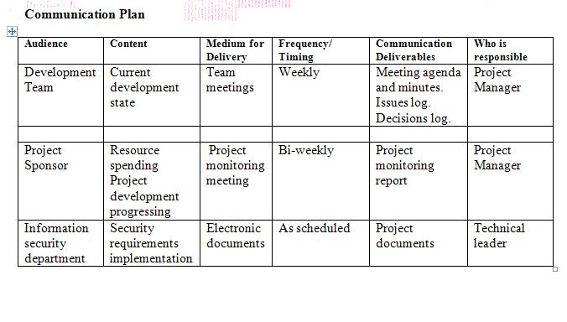
Communication Plan Sample

Slide 6
How to define …
Audience – that is your project stakeholders. Comprehensive and granular list of stakeholders is critical for communication plan, and for the project success
Content – anything you feel be important for the stakeholders to know. Be selective, send only relevant information

Slide 7
How to define (cont)
Medium for delivery – need your gut feeling what may work and what not, but also see recommendations below
Frequency – may be one time shot, or periodical update. Be reasonable but make sure that stakeholders know what they need all the time

Slide 8
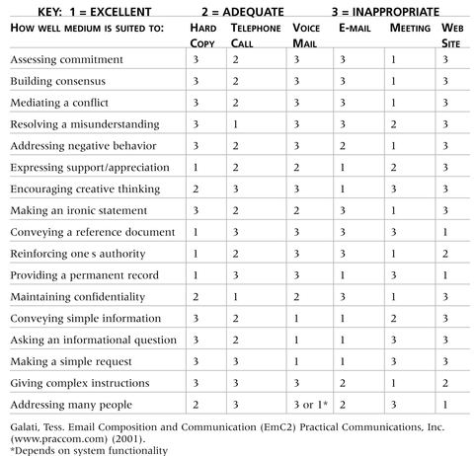
Table 10-2: Media Choice Table
Information Technology Project Management, Fifth Edition, Copyright 2007

Slide 9
How to define (cont)
Deliverables – define how information will be organized (formal document, notes, etc.)
Responsible person – one who will take responsibility for delivery, names or roles

Slide 10
Define medium: Face To Face
58% body language
35% tone
7% words

Slide 11
Challenges in (Global) IT
Cultural differences (different norms)
Language differences
Different working hours & time zones
Different knowledge levels

Slide 12
Communication Tips
Have approval of your broadcasting messages
Reflect communication actions in your project plan
Have a one responsible for each communication item

Slide 13
Communication Tools
Use communication tools
  Teleconferencing
  Sharepoint
  Email
Be aware about security issues
  Protect messages with encryption
  Use digital signature

